Slide 1


Slide 2
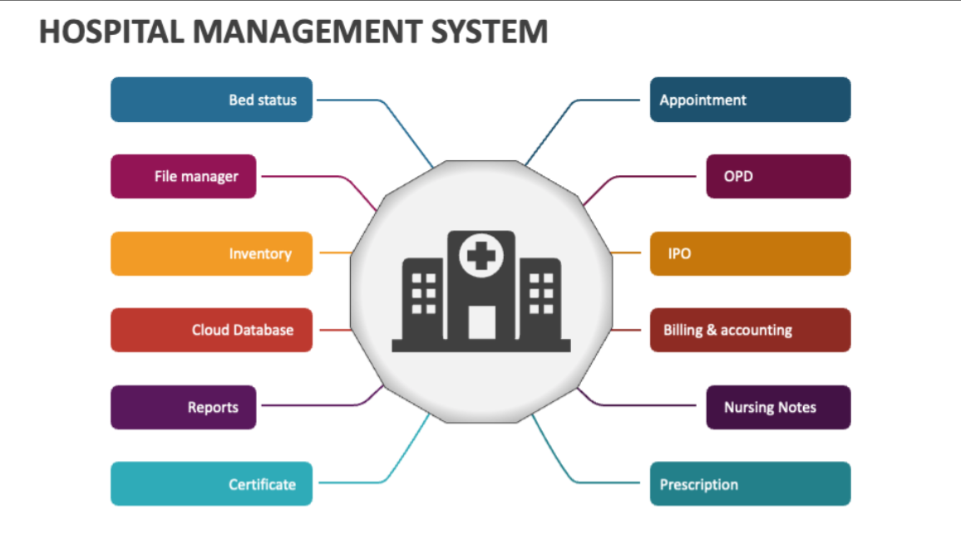

Slide 3
Bed Status:-
Bed status determination is crucial for operational effectiveness in healthcare settings. Patients are often placed under “observation status,” meant for those needing monitoring for 24-48 hours. In contrast, inpatient status applies to patients who require extended medical care, usually exceeding two midnights.
Appointment:-
A hospital appointment is a scheduled meeting with a healthcare provider at a specific time and location within a hospital setting, typically for a medical checkup, consultation, or treatment. It's an arrangement to receive medical care or address a health concern.
File Manager:-
It is a software application that helps manage and organize patient records, medical documents, and other important files. It provides a centralized and secure location for storing, searching, accessing, and updating these documents, improving efficiency and compliance.
OPD:-
OPD stands for Outpatient Department. It's the area where patients receive medical care and treatment without needing to be admitted as inpatients.

Slide 4
Inventory:-
Inventory refers to the collection of all medical resources needed for patient care, including supplies, equipment, and medications.
IPO:-
IPO stands for Initial Public Offering. This is when a private company, such as a hospital, sells shares to the public for the first time to raise capital. This allows the hospital to become publicly traded and raise funds to expand its operations, invest in new technologies, or pursue other growth opportunities.
Cloud DataBase:-
Is a system where the hospital's data, including patient records and other information, is stored and managed on remote servers via the internet, rather than being stored locally on the hospital's own physical servers. This allows for flexible access from anywhere, easier maintenance and updates, and scalability as the hospital's data needs grow.
Billing And Accounting:-
Billing focuses on generating and managing invoices for services rendered to patients, ensuring timely and accurate reimbursement from insurance companies and patients. Accounting, on the other hand, involves the broader management of financial information, including revenue generation, expense tracking, and compliance with financial regulations.

Slide 5
Reports:-
Reports are documents that communicate information about patients, events, or procedures. They can be written or oral, and they serve various purposes, including documenting care, facilitating communication between healthcare providers, and providing evidence of quality care. Reports can include things like consultation reports, incident reports, nursing shift reports, and patient care reports.
Nursing Notes:-
Nursing reports are documents created by nurses to communicate a patient's condition, treatment, and observations to other healthcare professionals. These reports, often shift reports, serve as a handover of information from one nurse to another, ensuring continuity of care. They can also be used in legal investigations and for evaluating patient care.
Certificate:-
It is a short, specialized program designed to equip individuals with the essential knowledge and skills for a career in the hospitality industry. These programs focus on core areas like hotel operations, customer service, and management techniques.

Slide 6
Prescription:-
A prescription is a written order from a physician or other authorized healthcare provider to a pharmacist or other healthcare professional, authorizing the dispensing and administration of a specific medication to a patient. It's a formal communication that includes details like the medication name, dosage, frequency, and duration of treatment.

Slide 7


